Slide 1
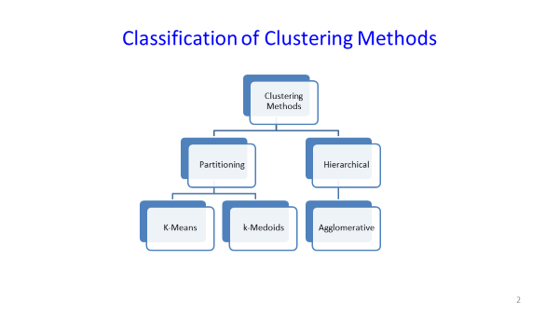
Hierarchical method of clustering - I
Introduction to Hierarchical clustering
Partitioning Vs. Hierarchical
Divisive

Slide 2
Introduction
A hierarchical method creates a hierarchical decomposition of the given set of data objects
A hierarchical clustering method works by grouping data objects into a tree of clusters
A hierarchical method can be classiﬁed as being either agglomerative or
divisive, based on how the hierarchical decomposition is formed
The agglomerative approach, also called the bottom-up approach, starts with each object forming a separate group

Slide 3
Introduction
It successively merges the objects or groups that are close to one another, until all of the groups are merged into one (the topmost level of the hierarchy), or until a termination condition holds
The divisive approach, also called the top-down approach, starts with all of the objects in the same cluster
In each successive iteration, a cluster is split up into smaller clusters, until eventually each object is in one cluster, or until a termination condition holds

Slide 4
Introduction
Hierarchical methods suffer from the fact that once a step (merge or split)
is done, it can never be undone
This rigidity is useful in that it leads to smaller computation costs by not
having to worry about a combinatorial number of different choices
However, such techniques cannot correct erroneous decisions

Slide 5
Agglomerative and Divisive Hierarchical Clustering
Agglomerative
This bottom-up strategy starts by placing each object in its own cluster and then merges these atomic clusters into larger and larger clusters, until all of the objects are in a single cluster or until certain termination conditions are satisﬁed
Most hierarchical clustering methods belong to this category
Divisive Hierarchical
This top-down strategy does the reverse of agglomerative hierarchical clustering by starting with all objects in one cluster
It subdivides the cluster into smaller and smaller pieces, until each object forms a cluster on its own or until it satisﬁes certain termination conditions, such as a desired number of clusters is obtained or the diameter of each cluster is within a certain threshold

Slide 6
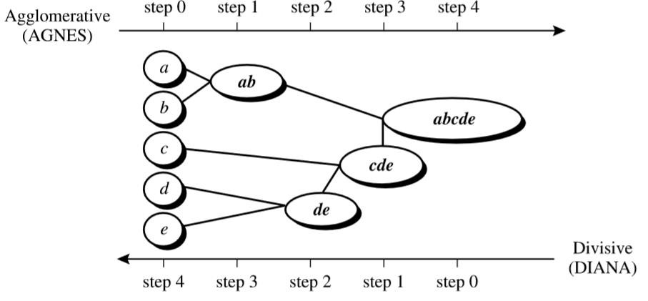
Agglomerative versus divisive hierarchical clustering
Figure: 1 Agglomerative and divisive hierarchical clustering on data objects{a,b,c,d,e}

Slide 7
Interpretation
Figure: 1 shows the application of AGNES (AGglomerative NESting), an agglomerative hierarchical clustering method, and DIANA (DIvisive ANAlysis), a divisive hierarchical clustering method, to a data set of ﬁve objects, {a,b,c,d,e}
Initially, AGNES places each object into a cluster of its own
The clusters are then merged step-by-step according to some criterion
Let’s say for example, clusters C₁ and C₂ may be merged if an object in C₁ and an object in C₂ form the minimum Euclidean distance between any two objects from different clusters

Slide 8
Interpretation
This is a single-linkage approach in that each cluster is represented by all of the objects in the cluster, and the similarity between two clusters is measured by the similarity of the closest pair of data points belonging to different clusters. The cluster merging process repeats until all of the objects are eventually merged to form one cluster.

Slide 9
Interpretation
In DIANA, all of the objects are used to form one initial cluster
The cluster is split according to some principle, such as the maximum Euclidean distance between the closest neighboring objects in the cluster
The cluster splitting process repeats until, eventually, each new cluster contains only a single object
In either agglomerative or divisive hierarchical clustering, the user can
specify the desired number of clusters as a termination condition

Slide 10
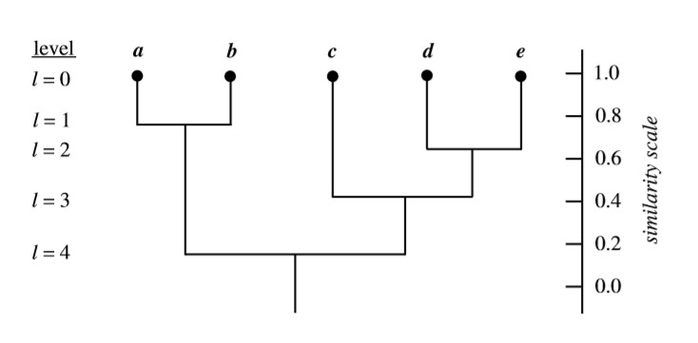
Dendrogram
Figure 2: Dendrogram representation for hierarchical clustering of data objects{a,b,c,d,e}

Slide 11
Dendrogram
A tree structure called a dendrogram is commonly used to represent the process of hierarchical clustering
It shows how objects are grouped together step by step
Figure: 2 shows a dendrogram for the ﬁve objects presented in Figure:1 , where l =0 shows the ﬁve objects as singleton clusters at level 0
At l =1, objects a and b are grouped together to form the ﬁrst cluster, and
they stay together at all subsequent levels

Slide 12
Dendrogram
We can also use a vertical axis to show the similarity scale between clusters
For example, when the similarity of two groups of objects, {a,b} and
{c,d,e}, is roughly 0.16, they are merged together to form a single cluster

Slide 13
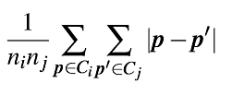
Measures for distance between clusters
Four widely used measures for distance between clusters are as follows, where|p−p’| is the distance between two objects or points, p and p’ , m_{i} is the mean for cluster, C_{i} and n_{i} is the number of objects in C_{i}
Minimum distance: d_{min}(C_{i},C_{j})= min_{p∈Ci, p’∈Cj} |p−p’|
Maximum distance: d_{max}(C_{i},C_{j})= max_{p∈Ci, p’∈Cj} |p−p’|
Mean distance: d_{mean}(C_{i},C_{j})= |m_{i}−m_{j}|
Average distance: d_{avg}(C_{i},C_{j}) =

Slide 14
Measures for distance between clusters
When an algorithm uses the minimum distance, d_{min}(C_{i},C_{j}), to measure the distance between clusters, it is sometimes called a nearest-neighbor clustering algorithm
Moreover, if the clustering process is terminated when the distance between nearest clusters exceeds an arbitrary threshold, it is called a single-linkage algorithm
If we view the data points as nodes of a graph, with edges forming a path between the nodes in a cluster, then the merging of two clusters, C_{i} and C_{j}, corresponds to adding an edge between the nearest pair of nodes in C_{i} and C_{j}

Slide 15
Measures for distance between clusters
Because edges linking clusters always go between distinct clusters, the resulting graph will generate a tree
Thus, an agglomerative hierarchical clustering algorithm that uses the minimum distance measure is also called a minimal spanning tree algorithm
When an algorithm uses the maximum distance, d_{max}(C_{i},C_{j}), to measure the distance between clusters, it is sometimes called a farthest-neighbor clustering algorithm
If the clustering process is terminated when the maximum distance between nearest clusters exceeds an arbitrary threshold, it is called a complete-linkage algorithm

Slide 16
Measures for distance between clusters
By viewing data points as nodes of a graph, with edges linking nodes, we can think of each cluster as a complete sub graph, that is, with edges connecting all of the nodes in the clusters
The distance between two clusters is determined by the most distant nodes in the two clusters
Farthest-neighbor algorithms tend to minimize the increase in diameter of
the clusters at each iteration as little as possible
If the true clusters are rather compact and approximately equal in size, the
method will produce high-quality clusters
Otherwise, the clusters produced can be meaningless

Slide 17
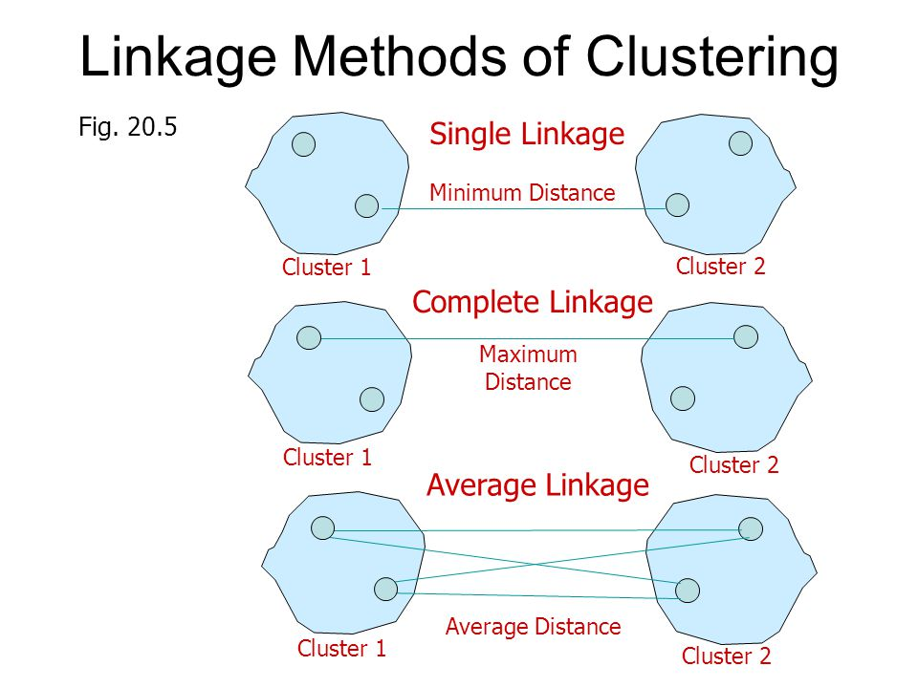
The minimum and maximum measures represent two extremes in measuring the distance between clusters
They tend to be overly sensitive to outliers or noisy data
The use of mean or average distance is a compromise between the minimum and maximum distances and overcomes the outlier sensitivity problem

Slide 18
Choice of measurement
The above minimum and maximum measures represent two extremes in measuring the distance between clusters
They tend to be overly sensitive to outliers or noisy data
The use of mean or average distance is a compromise between the minimum and maximum distances and overcomes the outlier sensitivity problem
Whereas the mean distance is the simplest to compute, the average distance is advantageous in that it can handle categorical as well as numeric data

Slide 19
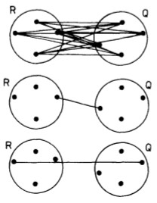
Illustration
(a)
Representation of some definitions of inter- cluster dissimilarity: (a) Group average
Nearest neighbor
Furthest neighbor
(b)
(c)

Slide 20
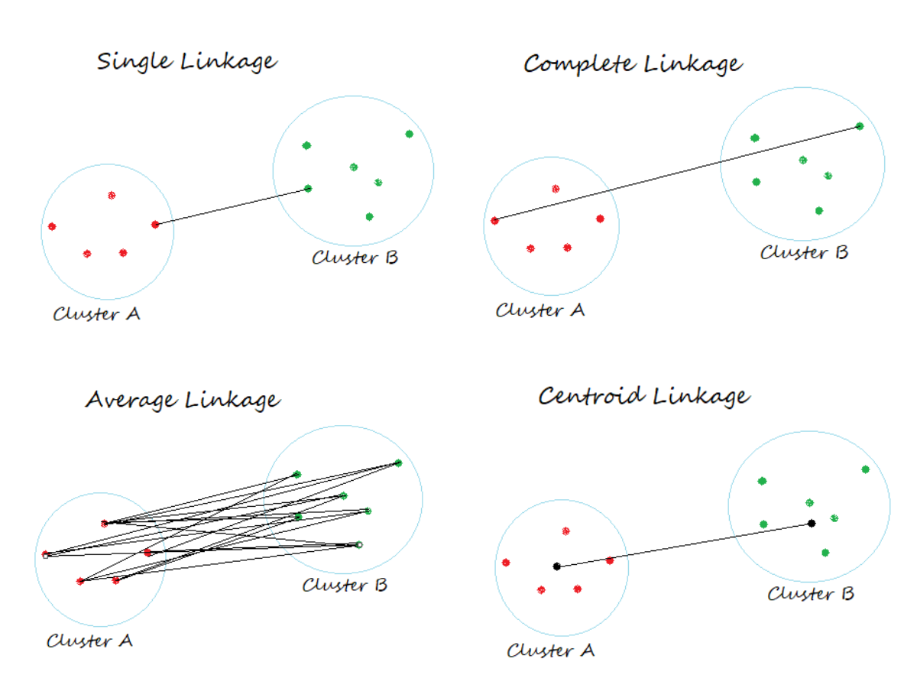

Slide 21
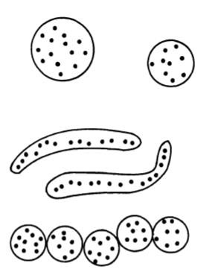
Illustration
(a)
Some types of clusters:
Ball-shaped
Elongated
Compact but not
well separated
Group average
(b)
Nearest neighbor
(c)
Furthest neighbor

Slide 22
Difﬁculties with hierarchical clustering
The hierarchical clustering method, though simple, often encounters
difﬁculties regarding the selection of merge or split points
Such a decision is critical because once a group of objects is merged or split, the process at the next step will operate on the newly generated clusters
It will neither undo what was done previously nor perform object
swapping between clusters

Slide 23
Difﬁculties with hierarchical clustering
Thus merge or split decisions, if not well chosen at some step, may lead to low-quality clusters
Moreover, the method does not scale well, because each decision to merge or split requires the examination and evaluation of a good number of objects or cluster
For improving the clustering quality of hierarchical methods is to integrate hierarchical clustering with other clustering techniques, resulting in multiple-phase clustering

Slide 24
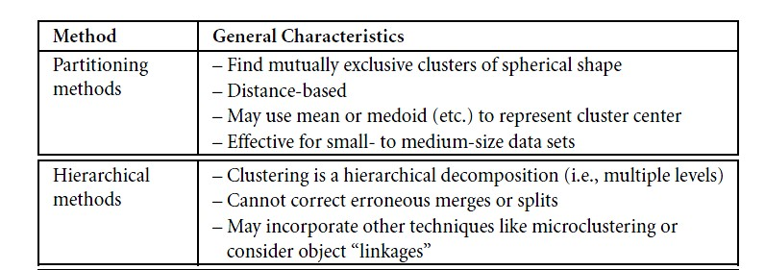
Partitioning Vs. Hierarchical

Slide 25
Following are the steps involved in agglomerative clustering (imp)
At the start, treat each data point as one cluster. Therefore, the number of clusters at the start will be K, while K is an integer representing the number of data points.
Form a cluster by joining the two closest data points resulting in K-1 clusters.
Form more clusters by joining the two closest clusters resulting in K-2 clusters.
Repeat the above three steps until one big cluster is formed.
Once single cluster is formed, dendrograms are used to divide into multiple clusters depending upon the problem.
There are different ways to find distance between the clusters. The distance itself can be Euclidean or Manhattan distance. Following are some of the options to measure distance between two clusters:
Measure the distance between the closes points of two clusters.
Measure the distance between the farthest points of two clusters.
Measure the distance between the centroids of two clusters.
Measure the distance between all possible combination of points between the two clusters and take the mean.

Slide 26
Once one large cluster is formed by the combination of small clusters, dendrograms of the cluster are used to actually split the cluster into multiple clusters of related data points. Let's see how it's actually done.

Slide 27
K-means versus hierarchical clustering

Slide 28
K means versus hierarchical clustering
K- means clustering Hierarchical clustering
Non-hierarchical methods, such as k-means, using a pre-specified number of clusters, the method assigns records to each cluster to find the mutually exclusive cluster of spherical shape based on distance
In this case, one can use mean or median as a cluster centre to represent each cluster
Hierarchical methods can be either agglomerative or divisive
Agglomerative methods begin with ‘n’ clusters and sequentially merge similar clusters until a single cluster is obtained.
Not required to specify number of clusters

Slide 29
K means versus hierarchical clustering
K- means clustering Hierarchical clustering
These methods are generally less computationally intensive and are therefore preferred with very large datasets
Divisive methods work in the opposite direction, starting with one cluster that includes all records
Hierarchical methods are especially useful when the goal is to arrange the clusters into a natural hierarchy.
More computationally intensive

Slide 30
K means versus hierarchical clustering
K- means clustering Hierarchical clustering
A partitioning (K- means) clustering a simply a division of the set of data objects into non- overlapping subsets (clusters) such that each data object is in exactly one subset)
A hierarchical clustering is a set of nested clusters that are organized as a tree

Slide 31

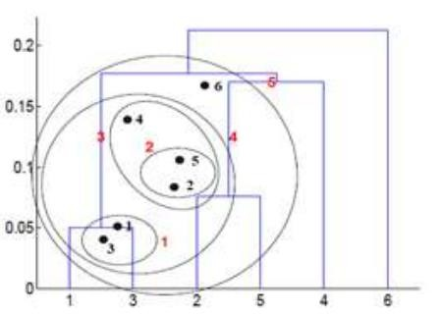
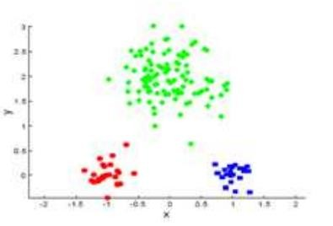
K means versus hierarchical clustering
Un-nested cluster Nested cluster
Ashok, A.R., Prabhakar, C.R. and Dyaneshwar, P.A., Comparative Study on Hierarchical and Partitioning Data Mining Methods.

Slide 32
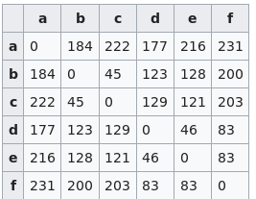
K means versus hierarchical clustering
Hierarchical clustering does not assume a particular value of ‘𝑘’, as needed by 𝑘-means clustering
The generated tree may correspond to a meaningful taxonomy
Only a distance or “proximity” matrix is needed to compute the
hierarchical clustering
Proximity
matrix

Slide 33
K means versus hierarchical clustering
K Means clustering Hierarchical clustering
In K Means clustering, since one start with random choice of clusters, the results produced by running the algorithm multiple times might differ
K Means is found to work well when the shape of the clusters is hyper spherical (like circle in 2D, sphere in 3D)
Results are reproducible in
Hierarchical clustering
Hierarchical clustering don’t work as well as, k means when the shape of the clusters is hyper spherical

Slide 34
K means versus hierarchical clustering
K Means clustering Hierarchical clustering
In hierarchical clustering one can stop at any number of clusters, one find appropriate by interpreting the dendrogram
K Means clustering requires prior knowledge of K i.e. no. of clusters one want to divide your data into

Slide 35
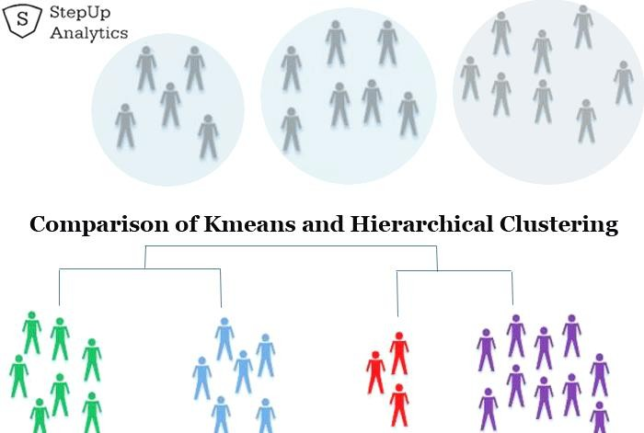
K means versus hierarchical clustering
https://stepupanalytics.com/difference-between-k-means-clustering-and-hierarchical-clustering/

Slide 36
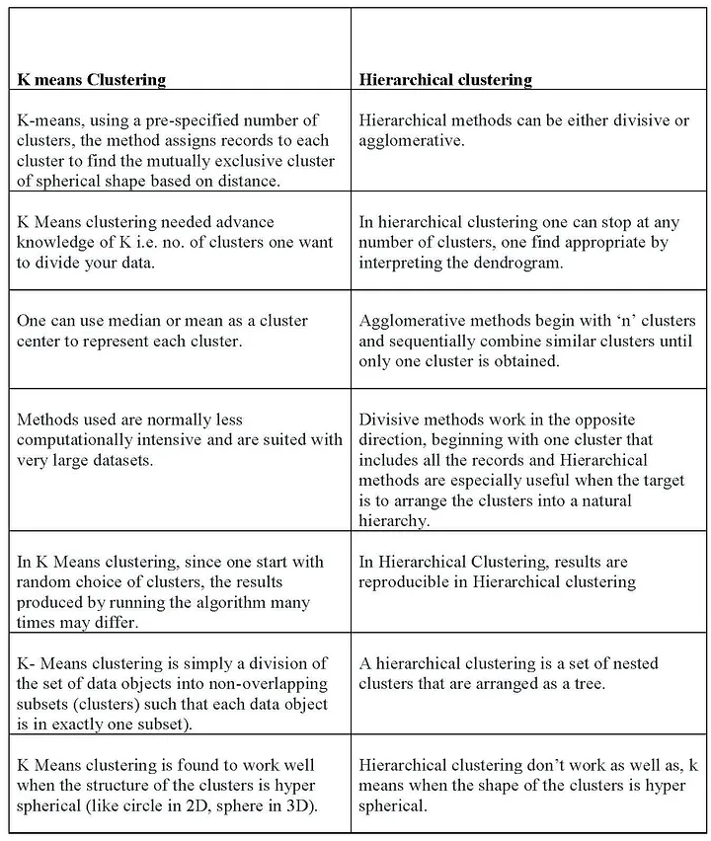

Slide 37
Hierarchical clustering
Advantages
Ease of handling of any forms of similarity or distance
Consequently, applicability to any attributes types

Slide 38
Limitations of Hierarchical Clustering
Hierarchical clustering requires the computation and storage of an n×n distance matrix. For very large datasets, this can be expensive and slow
The hierarchical algorithm makes only one pass through the data. This means that records that are allocated incorrectly early in the process cannot be reallocated subsequently
Hierarchical clustering also tends to have low stability. Reordering data or
dropping a few records can lead to a different solution

Slide 39
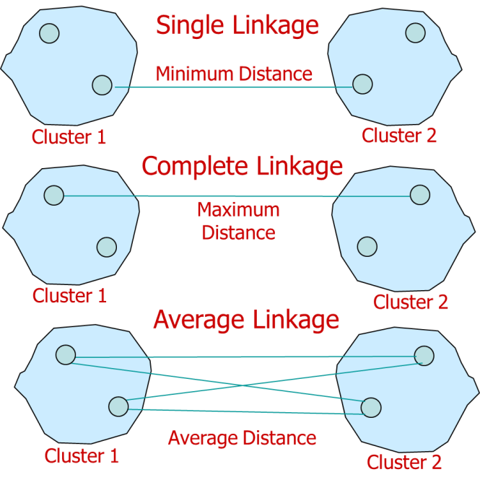
Limitations of Hierarchical Clustering
With respect to the choice of distance between clusters, single and complete linkage are robust to changes in the distance metric (e.g., Euclidean, statistical distance) as long as the relative ordering is kept.
In contrast, average linkage is more influenced by the choice of distance metric, and might lead to completely different clusters when the metric is changed
Hierarchical clustering is sensitive to outlier

Slide 40
Average-linkage clustering
Compromise between Single and Complete Link
Strengths
  Less susceptible to noise and outliers
Limitations
  Biased towards globular clusters

Slide 41
Ward’s distance algorithm
This is an alternative approach for performing cluster analysis.
It falls under hierarchical clustering technique
Basically, it looks at cluster analysis as an analysis of variance problem, instead of using distance metrics or measures of association.
Ward’s is said to be the most suitable method for quantitative variables.
Ward's method starts out with n clusters of size 1 and continues until all the observations are included into one cluster.
This method is most appropriate for quantitative variables, and not binary variables.
Ward’s method says that the distance between two clusters, A and B, is how much the sum of squares will increase when we merge them:

Slide 42
Distance between two clusters
Ward’s distance between clusters C_{i} and C_{j} is the difference between the total within cluster sum of squares for the two clusters separately, and the within cluster sum of squares resulting from merging the two clusters in cluster C_{ij}
D (C ,C )= + ∑(x − r ) − ∑(x − r )
x∈C _{j} x∈C_{ij}
w i j ∑
x∈C_{i}
(x − r )
2
2
2
i
j
ij
r_{i}: centroid of C_{i}
r_{j}: centroid of C_{j}
r_{ij}: centroid of C_{ij}
Unlike the others. Instead of measuring the distance directly, it analyzes the variance of clusters. Ward’s is said to be the most suitable method for quantitative variables.

Slide 43
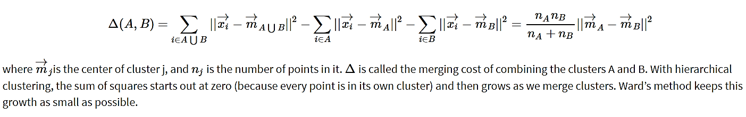
There are four methods for combining clusters in agglomerative approach. The one we choose to use is called Ward’s Method. Unlike the others. Instead of measuring the distance directly, it analyzes the variance of clusters. Ward’s is said to be the most suitable method for quantitative variables. Ward’s method says that the distance between two clusters, A and B, is how much the sum of squares will increase when we merge them:
where m→jis the center of cluster j, and nj is the number of points in it. Δ is called the merging cost of combining the clusters A and B. With hierarchical clustering, the sum of squares starts out at zero (because every point is in its own cluster) and then grows as we merge clusters. Ward’s method keeps this growth as small as possible.

Slide 44
With hierarchical clustering, the sum of squares starts out at zero (because every point is in its own cluster) and then grows as we merge clusters. Ward’s method keeps this growth as small as possible. This is nice if you believe that the sum of squares should be small. Notice that the number of points shows up in ∆, as well as their geometric separation. Given two pairs of clusters whose centers are equally far apart, Ward’s method will prefer to merge the smaller ones.

Slide 45
Ward’s Method: This method does not directly define a measure of distance between two points or clusters. It is an ANOVA based approach. One-way univariate ANOVAs are done for each variable with groups defined by the clusters at that stage of the process. At each stage, two clusters merge that provide the smallest increase in the combined error sum of squares.

Slide 46
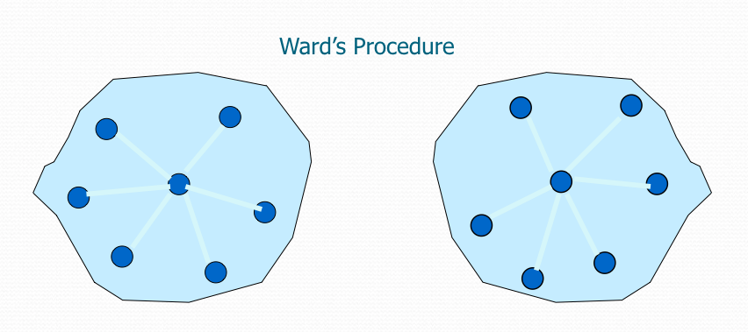

Slide 47
Ward’s distance for clusters
Similar to group average and centroid distance
Less susceptible to noise and outliers
Biased towards globular clusters
Hierarchical analogue of k-means
– Can be used to initialize k-means

Slide 48
Distance between two clusters
Ward’s distance between clusters C_{i} and C_{j} is the difference between the total within cluster sum of squares for the two clusters separately, and the within cluster sum of squares resulting from merging the two clusters in cluster C_{ij}
D (C ,C )= + ∑(x − r ) − ∑(x − r )
x∈C _{j} x∈C_{ij}
w i j ∑
x∈C_{i}
(x − r )
2
2
2
i
j
ij
r_{i}: centroid of C_{i}
r_{j}: centroid of C_{j}
r_{ij}: centroid of C_{ij}
Unlike the others. Instead of measuring the distance directly, it analyzes the variance of clusters. Ward’s is said to be the most suitable method for quantitative variables.

Slide 49
Advantages of Ward's Method:
Compact Clusters: It creates clusters that are more compact and similar in size.
Good for Euclidean Spaces: It works well with Euclidean distance metrics, making it ideal for continuous data.
Less Sensitive to Outliers: Because it minimizes variance rather than absolute distance, it tends to be less influenced by outliers than some other methods.
Disadvantages of Ward's Method:
Computational Complexity: Calculating the increase in variance can be computationally intensive for very large datasets.
Sensitive to Initial Data Structure: If the data doesn’t naturally form spherical clusters, Ward’s method may not perform as well as other linkage methods.

Slide 50
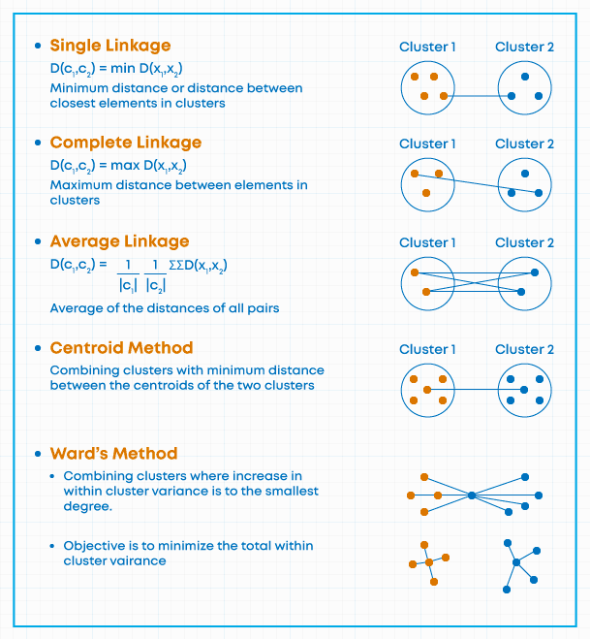

Slide 51
Hierarchical Clustering: Comparison
5
1
4
1
3
2
5
5
5
2
1
2
2
Simple linkage
3
6
3
6
3
1
4
4
Complete linkage
4
5
1
5
4
1
2
2
5
2
Ward’s Method
5
2
3
6
Group Average
3
6
3
1
1
4
4
4
3

Slide 52
Similarity
Two most popular methods: hierarchical agglomerative clustering and k- means clustering
In both cases, we need to define two types of distances: distance between two records and distance between two cluster
In both cases, there is a variety of metrics that can be used

Slide 53
Reference
Hierarchical Clustering with Python and Scikit-Learn - Stack Abuse
Distance Measure – FasterCapital
(16) Hierarchical clustering: The simplest clustering algorithm | LinkedIn

Slide 54
Thank You

